Slide 1
Map of Tasks
Algorithms and Data structures

Slide 2
Introduction
Optimizing task completion strategy for IIOT contest
The Industrial Internet of Things (IIOT) represents a convergence of industry with the power of connected technology.
In preparation for the competition, students face a complex task scheduling challenge.
Each task, varying in complexity and time requirements, is a stepping stone towards building a competitive IIOT solution.

Slide 3
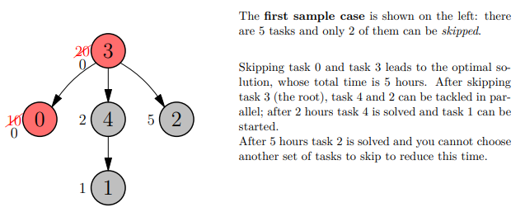
Problem description
Understanding the challenge
Objective: calculate the minimum hours to solve all tasks.
Constraints: task dependencies and a limited number of 'cheats'.
Example:

Slide 4
Algorithm overview
Dynamic approach
Structure: tasks are nodes in a rooted tree; parent-child relationships indicate task dependencies.
Traversal: Depth-First Search (DFS) is used to traverse this tree and calculate the cost of each subtree.
Cheating Strategy: at each node, we decide whether to 'cheat' on the task based on its impact on the overall completion time.

Slide 5
Dynamic programming in detail
Deep dive into Dynamic Programming
Memoization technique: cache the minimum time required to complete each subtree with a certain number of cheats.
Recursive 'cheat' function: calculates the minimum time for each node, considering whether to cheat on the task or complete it normally.
Optimal substructure: the solution for each node is based on the solutions of its children, a hallmark of dynamic programming.

Slide 6
Algorithm steps
Breaking down the algorithm steps
Initialize the task tree and populate each node with the respective task time.
Starting from the leaves, calculate the total time required for each subtree and propagate this information up the tree.
Use a priority queue to select tasks to 'cheat' based on the potential time savings, prioritizing the highest values first.
Update the total time at each node after applying a 'cheat', ensuring that the integrity of the task dependencies is maintained.
Time Complexity: O(N * C), where N is the number of nodes (tasks), and C is the number of cheats. This is due to processing each node with each possible number of remaining cheats.

Slide 7
Computational complexity
Computational complexity calculation
Key Factors: Depends on the number of nodes (N) and the number of cheats (C).
Tree Construction: O(N) - Each node is processed once to build the tree.
Dynamic Programming (cheat Function): O(N * C) - Each node is evaluated with each possible number of remaining cheats. Memoization ensures each state is computed only once.
Overall Complexity: O(N * C) - Dominated by the dynamic programming part, as it's the more complex operation.

Slide 8
Limitations and alternatives
Exploring limitations and alternatives
Limitations: the algorithm may face scalability issues with very large trees or a high number of cheats due to its polynomial complexity.
Alternative methods: greedy algorithms could offer faster computations but may not always yield the optimal solution. Brute force approaches are impractical for large N and C due to exponential time complexity.

Slide 9
Conclusions
Conclusions and future directions
Achievements: successful implementation of a dynamic programming approach to efficiently solve a complex problem.
Insights: gained a deeper understanding of optimizing algorithms and managing computational resources effectively.
Future work: potential improvements include exploring different data structures for efficiency gains or extending the algorithm to handle more complex task dependencies and constraints.

